Slide 1
SEPT - Major Project

Slide 2
Team members:
BURR, Harrison (s3708981)
HUANG, Jasper (s3423585)
LYBEROPOULOS, Michael (s3787260)
PHUNG, Nikita (s3783287)
TAN, Joel (s3758729)

Slide 3
What we’ve built
React webapp
RESTful Spring API
HSQL database
Notes:
Author: Nikita What we have built is a restful API that aims to automate the process of booking appointments with employees at certain types of business. Our service allows business owners to set working hours, and for customers to book appointments with them. This API can support many businesses simultanously, and it is fairly simple to build an application that consumes the API.

Slide 4

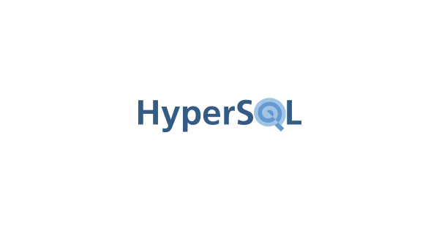


Key features.
Flexible
Prepared for the changing needs of the workplace
Notes:
Author: Joel The two key features we want to stress are the flexibility of our API, and the full cloud deployment.
Our API is designed to work in a variety of contexts, and the API is structured well so that future releases of the software could easially expand upon the existing work.
In addition to this, our app runs completely on AWS, requiring zero deidcated physical machines to run.

Slide 5
Development Process
Task selection
Code is written
Code is uploaded
Code reviewed by other team member
Code integrated into the codebase
Notes:
Author: Jasper Our development process was in short a series of 2 week sprints leading to specific functional outcomes.
Our team would meet three days a week every week, checking in and ensuring that we were on track to complete the project on time.
Every sprint had a loose set of tasks to be completed by project members, these tasks were selected by team members in consultation with the product owner, team members would assign themselves to these tasks as they saw fit, completing them and pushing their work to the shared codebase for review. Each sprint would end with a review to discover issues within the project and the process, these issues would be addressed and the group would start another sprint.

Slide 6



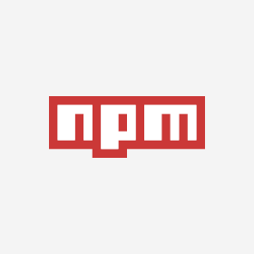


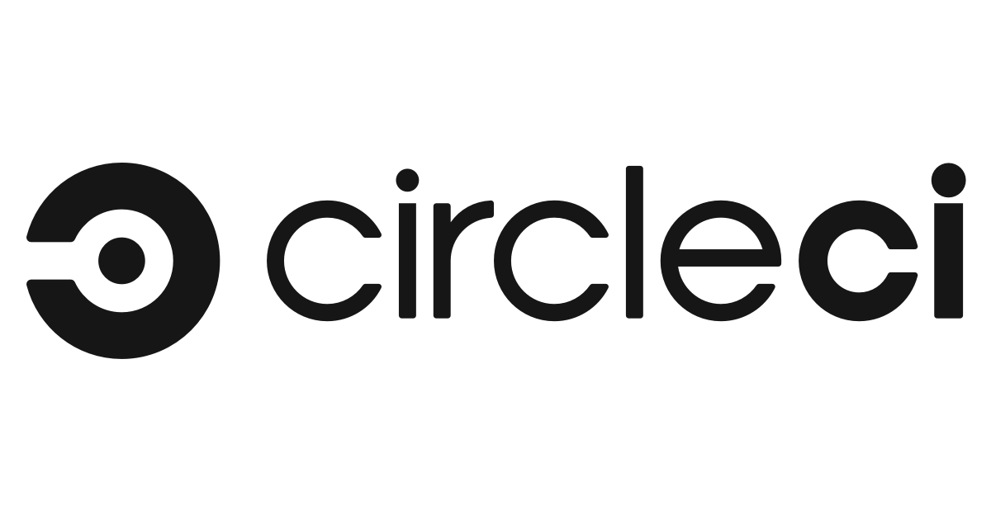
Technologies
Notes:
Author: Michael Github.
Throughout development, we used Github as a remote code repository and a version control system. Updates to the code were developed on independent branches, then merged to the shared development branch until we were confident the code was stable enough to push to the master branch.
Clickup.
Clickup was our main task management tool for the project, any work that needed to be completed was placed here. The Clickup boards were set up for an Agile-Sprint task flow, with team members taking ‘open’ tasks, assigning them to themselves, then placing them in ‘complete’ after their code had been reviewed and merged into the development branch.
Maven.
Used to automate the building of the java based backend.
Node PackageManager
Used to automate the frontend demo builds.
Discord.
Team communication, voice meetings and text chats.
CircleCI
Continuous integration and continuous deployment platform.

Slide 7
Retrospective.
Notes:
Author: Harrison

Slide 8
Things that went well
Good end product
Frequent and high quality communication between team members
Notes:
- Product owner seemed satisfied by the end result.
- The team communicated well and worked hard to complete tasks
- Team members picked their own tasks well.

Slide 9
Improvements that could be made
Potential bottlenecks in existing code
Future task effort estimates should be better
Notes:
- Time estimates could have been better.
- There are some documented bugs that could be fixed

Slide 10
Surprises
Difficulty learning web technologies
Database structure changes during development
Notes:
- Surprised by hard hard some of the technolgy was to learn.
- Some of the backend entities needed to be changed a few times during development

Slide 11
Learning
SPA
Docker
Notes:
- React and that React sucks.
- Single page application development
- How to write code that integrates into other peoples code.
- How to use mockito
- Docker

